Slide 1
Transfusing Blood Safely
Blood Transfusion Safety

Slide 2
Program Goals and Objectives
Describe the types of blood products prescribed for common conditions
Describe transfusion reactions and their treatments
Apply evidence-based guidelines for the safe administration of blood products
Apply the nursing process to prevent, identify, and treat potential complications associated with blood administration

Slide 3
Program Goals and Objectives
To ensure a safe blood transfusion process by:
Implementing a system to prevent blood administration errors from occurring
Identifying potential errors and/or near misses
Reducing the untoward effects of adverse transfusion reactions if they do occur

Slide 4
THE TRANSFUSION OF BLOOD AND BLOOD COMPONENTS

Slide 5
The transfusion of blood and blood products can be a lifesaving procedure, but it carries risks.

Slide 6
Errors, such as the administration of the wrong blood to the wrong patient, can lead to long-term health problems and even death. Extreme caution is essential when preparing a patient to receive a blood transfusion.

Slide 7
Following procedures that ensure accurate identification of the patient and verification of blood transfusion components can help prevent potentially fatal errors.

Slide 8
Keep in mind that the Centers for Medicare and Medicaid Services considers a blood incompatibility error a hospital-acquired condition because it can be reasonably prevented using a variety of best practices.

Slide 9
Red blood cells (RBCs)
Concentrate of RBCs from whole blood
To restore or maintain oxygen-carrying capacity in patients with symptomatic anemia⁵
To increase RBC mass in patients with acute anemia caused by trauma, surgical blood loss, or chemotherapy¹
To increase RBC mass in patients with chronic anemia with associated cardiovascular decompensation

Slide 10
Leukocyte-reduced RBCs
Concentrate of RBCs from whole blood with white blood cells removed from the blood component during apheresis collection or by filtration of the blood product.
To restore or maintain oxygen-carrying capacity in symptomatic anemia in patients at risk for reactions caused by leukocyte antibodies
To treat symptomatic anemia in patients who are immunocompromised
To increase RBC mass in acute anemia caused by trauma, surgical blood loss, or chemotherapy in patients at risk for reactions caused by leukocyte antibodies
To increase RBC mass in chronic anemia with associated cardiovascular decompensation in patients at risk for reactions caused by leukocyte antibodies

Slide 11
Platelets
Concentrate of platelets separated from whole blood or blood obtained by apheresis or pooled from multiple donors
To control for bleeding that results from decreased circulating platelets or malfunctioning platelets
To increase the platelet count in patients who require an invasive procedure
To prevent bleeding in patients with a low platelet count

Slide 12
Plasma
Noncellular portion of blood that's separated and frozen after donation and contains coagulation factors and other proteins
To temporarily reverse the effects of warfarin
For plasma exchange (especially in patients with thrombotic thrombocytopenia)
For patients with factor deficiency if concentrate is unavailable
For patients with abnormal coagulation test results before invasive procedures
For patients with liver disease with protein synthetic defect
For patients with dilutional coagulopathy
For patients with consumptive coagulopathy (DIC)

Slide 13
Cryoprecipitate
Also known as cryoprecipitated antihemophilic factor, noncellular blood component that's prepared by thawing fresh frozen plasma, recovering the insoluble precipitate, and then refreezing the precipitate within 1 hour of collection; contains concentrated levels of fibrinogen, factor VIII, von Willebrand factor, factor XIII, and fibronectin
For patients with factor deficiency when factor-specific concentrate is unavailable
For patients with hypofibrinogenemia
For patients with dysfibrinogenemia
For patients with von Willebrand disease

Slide 14
Equipment
Antiseptic pad (chlorhexidine-based, povidone-iodine, or alcohol)
Blood or blood product
Blood or blood product administration set
Blood request form
Disinfectant pad
Gloves
IV pole
Stethoscope
Vital signs monitoring equipment
Optional: 250 mL of normal saline solution, blood warming device and an additional administration set, IV catheter insertion equipment, labels, or other personal protective equipment, prescribed pre-medications.
Straight line and Y-type blood administration sets contain a standard 170- to 260-micron blood filter designed to eliminate blood clots and cellular debris that occur during blood storage.

Slide 15
You received an order to Crossmatch a patient
Review chart
Review lab work, lab tech to draw Type/screen or Type/Cross
Review physician orders, make sure you have a type and screen ordered
When the order for RBC’s is entered in the EHR/LIS an ABO/RH and antibody screen will be automatically ordered

Slide 16
Obtain Informed Consent
Patient or responsible person must sign an informed consent before calling the lab unless is an emergency
Physician must sign the blood consent form

Slide 17
Patient Transfusion Awareness
Risks must be explained to the patient ( before the transfusion) by the physician
Signs of adverse reactions to the transfusion
Teaching is required for all patients (in and out)
Patient signature required —a copy remains with chart

Slide 18
Patient Preparation Before Retrieving Blood From the Lab
Teaching completed
IV established
Supplies assembled
Consent for transfusion signed by physician and patient

Slide 19
Acquisition of Blood
The blood transfusion tag will be printed in the lab.
Licensed nursing staff should present the blood transfusion tag to the lab technician to check out the blood.

Slide 20
Acquisition of Blood Cont.
Check the unit of blood for:
Visible signs of gas, hemolysis, cloudiness, or clots
If any of these findings are present, the lab tech will choose another unit, and it will be checked in the same manner.

Slide 21
Acquisition of Blood Cont.
Look closely at the Blood Transfusion Unit Tag
Verify that the ABO, Rh, unit number, expiration date, and the blood bank armband alpha-numeric sticker on the tag match exactly with the actual unit of blood as you do a verbal read back with the technician.
The patient must have an arm band on with the exact matching blood bank alpha-numeric sticker.

Slide 22
Form Update

Slide 23
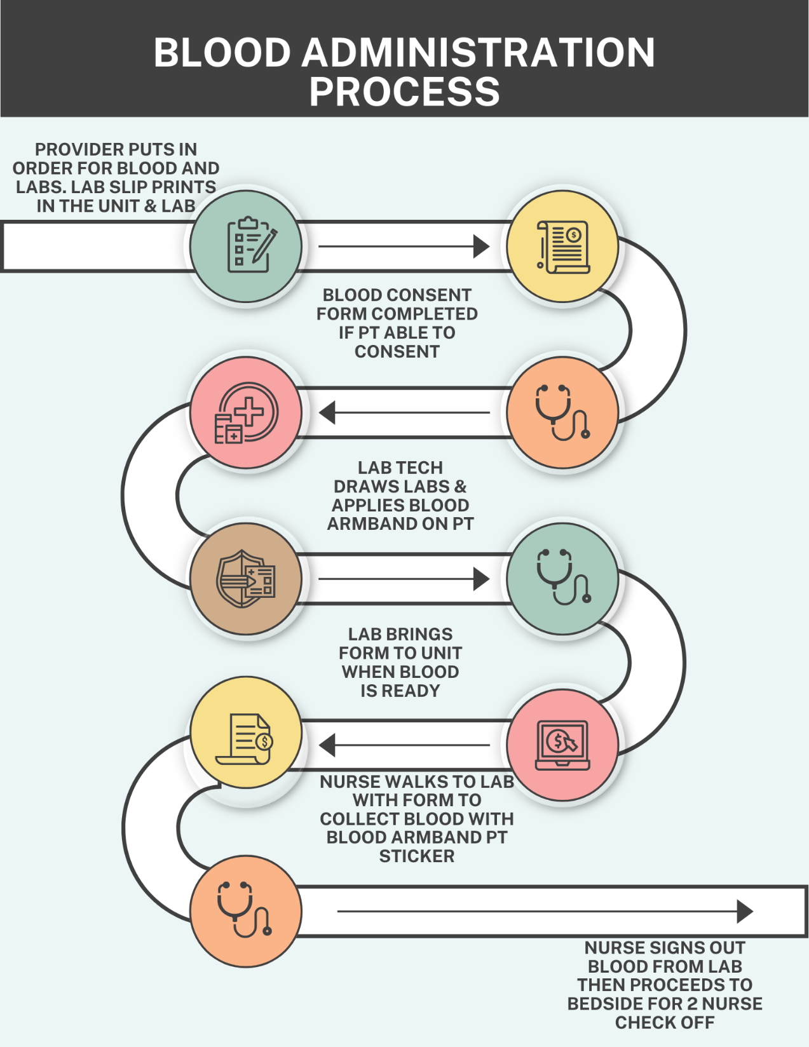

Slide 24
Blood Administration Must Be’s
Be
started within 30 minutes
Be
infused within 4 hours
Be
Not put in any unauthorized refrigerator.
Be
Not heated in a microwave
Be
checked by 1 RN and 1 licensed person( RN, LVN) at the patient’s bedside before infusing

Slide 25
Bedside Patient Identification
Check
Check the patient’s hospital arm band
Check
Document
Bring WOW to Bedside and document
Check the patient’s Blood Bank arm band
At least one RN and another licensed nurse must confirm the patient ID with at least two unique identifiers
Confirm

Slide 26
Bedside Patient ID
The Transfusion Unit Tag # (attached to blood), with the actual unit of blood
Check blood expiration date
Check blood unit number
Check blood Group and Type
Check both arm bands

Slide 27
Patient’s Blood Bank Bands and Patient Identification Arm Bands
Must match EVERYTHING!!
The unit of Blood
The Transfusion Unit Tag attached to blood
The patient’s physically attached Blood Bank armband
Both nurses must sign attestation on Unit Tag before starting the transfusion
An RN needs to be involved in the complete ID process

Slide 28
Flow Rates
50 ml hour X 15 minutes
Stay with the patient for the first 15 minutes
Patient needs to be monitored every 30 minutes until transfusion is over.
Infuse remainder over 2-4hrs. No more than 4 hours total. Use Nursing Judgement!

Slide 29
Adverse Transfusion Reactions
Usually manifests within the first 15 minutes
Initial signs: fever, chills, urticaria
Later signs: back pain, renal failure, dyspnea
Hemolytic reaction=quickly due to ABO or Rh incompatibility
May lead to DIC or death
Refer to Lippincott Procedural manual for additional reactions. Print procedure prior to administering blood products as a reference.

Slide 30
Adverse Transfusion Reactions
Anticipate a bacterial reaction
Patient teaching is paramount. May develop after transfusion (delayed)
Hypothermia: may need a blood warming unit
Febrile nonhemolytic reactions resulting from leukocyte or platelet antibodies, plasma protein antibodies, or cytokines from donor leukocytes
FLUID OVERLOAD!

Slide 31
Adverse Transfusion Reactions
Later signs: back pain, renal failure, dyspnea
Hemolytic reaction=quickly due to ABO or Rh incompatibility
May lead to DIC or death
Febrile reaction ((temperature increase of 2° F [1° C] or more occurring during or shortly after a transfusion
Notify MD and document
BP raises or lowers 20mmHg from pre-infusion vitals
Initial signs: fever, chills, urticaria

Slide 32
Transfusion Reaction Nursing Care
STOP THE TRANSFUSION AND STAY WITH THE PATIENT
HAVE SOMEONE Notify or call the Physician
KEEP VEIN OPEN WITH NS
Fill out reaction form
EMERGENCY CARE AS NEEDED
Notify Lab ASAP
Place the blood bag (even if it's empty), attached IV fluids, and administration set with the related forms and labels in a laboratory biohazard transport bag for the lab to collect.

Slide 33
Additional Transfusion Reaction Protocols
Keep the blood and tubing for the lab
Draw blood from the patient
Complete the SCH Transfusion Reaction Report in the EHR, print and send to lab along with the bag & tubing if blood is discontinued

Slide 34
Filters
Filters must be used for all blood products e.g.: PRBCs, Platelets, FFP, cryoprecipitate
One filter per unit

Slide 35
Documentation
All documentation will be performed in the EHR (Cerner)
Use Transfusion Reaction Report Form when a reaction identified.

Slide 36
BTNN

Slide 37
Pick up blood, go to bedside with second nurse. Go to Interactive View/I&O > Adult Lines-Devices > Blood Product Transfusion. You can enter IV site checks, Vital Signs, Blood Administration, & Rate changes all from this section.

Slide 38
Fill in information.

Slide 39
Double CLICK in light grey square to start entering in information at the bedside with second license person.

Slide 40
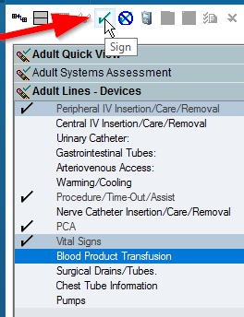
Doucumentation

Slide 41
Insert Witnessed By. (Second Nurse)

Slide 42
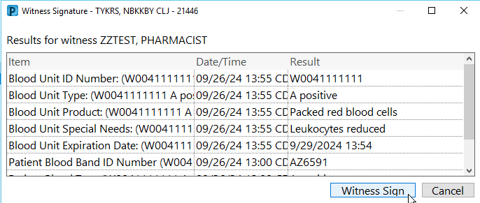

Slide 43
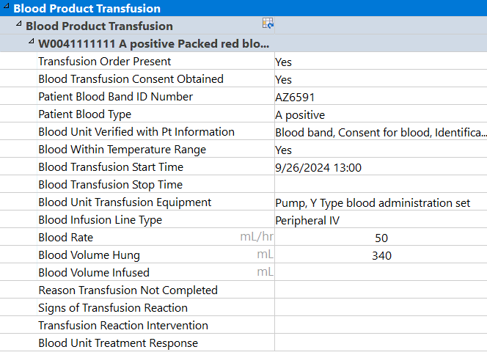
Witness signs. The entered/witnessed information then turns black.

Slide 44
Use this area to enter Vital signs, Rate changes, and signs of transfusion reaction.

Slide 45
Right CLICK and create a time column for when you changed the rate. Add rate change, reaction comment, & Vital signs.

Slide 46
Document Stop Time, Reactions, and Patient’s Response after infusion is complete. (<4hrs from time when released from Blood Bank)

Slide 47
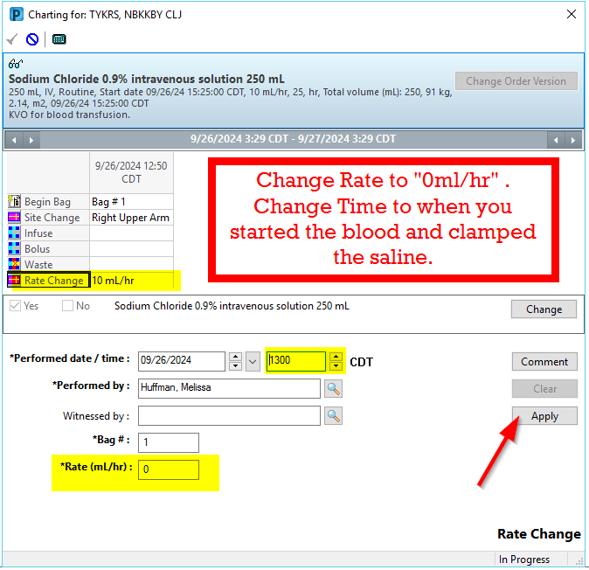
*****Reminder***** Change the rate of the NS 250ml flush bag to 0ml/hr when you start the blood and back to KVO after the blood is stopped.

Slide 48
Poll: Are we using this form?

Slide 49
Emergency Room Patients
All Documentation will be done in the EHR
If patient is transferred while still receiving blood, the chart copy of the Transfusion Unit Tag attached to the unit should stay with the unit infusing

Slide 50
Emergency Room Patients
Appropriate data relayed to receiving nurse
Document

Slide 51
Transfusion Unit Tag
What do we do with it?
Make sure it is completed and signed with all 4 signatures.
At conclusion of transfusion, place the signed transfusion unit tag in the patient’s chart. Send a copy to the lab.

Slide 52
OPERATING ROOM patients receiving blood follow the same protocols

Slide 53
Miscellaneous
Do not delay giving blood for a MTP to draw labs (type/cross or type/screen). Draw first if possible, however may skip if MTP activated.
Call lab if you suspect a MTP may be needed so they can be at the bedside for lab draws.
Type and Screen is done on admission for Platelets and Plasma.
Both products requires filters for infusion
Do not accept blood tubes from EMS. Bedside staff collects blood in the pt room then labels it at the bedside with 2 patient identifiers.
Pt labels are now being printed in registration with armbands. Use those labels at the bedside to label specimens until lab stickers can be printed.

Slide 54
Un-crossmatched Blood For an Emergent Patient
Lab will provide form and blood upon request.
A clot and EDTA must be drawn stat
The armband must be placed on the patient by the Lab personnel
Request can be signed by RN if verbal order is given, but physician must sign within 24 hrs.
O negative will be given to start, but as soon as Group and Type is completed Type specific will follow.
Notes:
Lab will provided form and blood upon request

Slide 55
Disposal of All Transfusion Bags and Tubing
All tubing and spent bag are to be placed in a biohazard bag and disposed of properly.

Slide 56
Discharge after Transfusion
Patient will receive blood transfusion discharge instruction sheet.

Slide 57
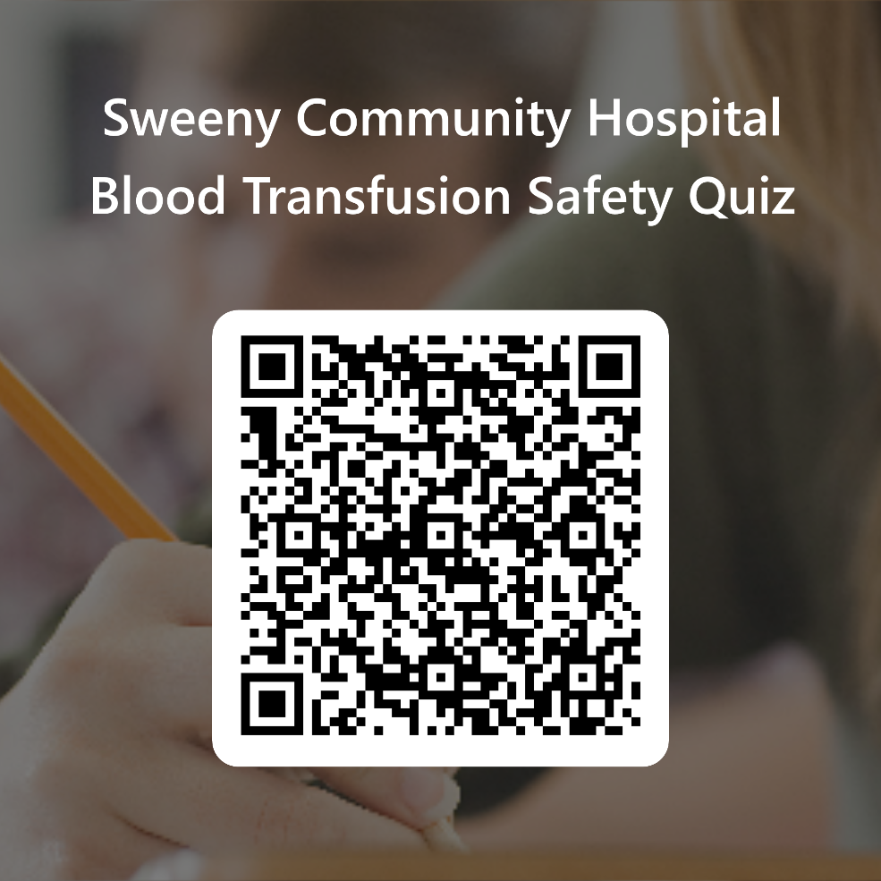
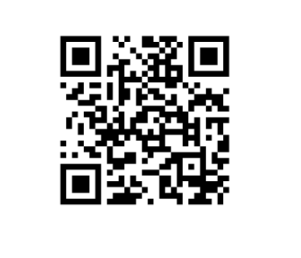
Following the link or scan the QR code for the Required Quiz.
https://forms.office.com/r/z5Kt9JkQTd

