Slide 1
Transfusing Blood Safely
Blood Transfusion Safety

Slide 2
Program Objective
Upon completion of this program, the participant will be able to administer blood/component transfusions safely, and, when indicated, to intervene quickly to reduce patient morbidity should an adverse transfusion reaction occur

Slide 3
Goals of the SCH Blood Safety Program
To establish a safe blood transfusion system at SCH by:
Implementing a system to prevent blood administration errors from occurring
Identifying potential errors and/or near misses
Reducing the untoward effects of adverse transfusion reactions if they do occur

Slide 4
After Completing This Program The Participate will be able to:
Complete a lab Blood Bank Request for crossmatch and a type and screen in the EHR
Obtain informed consent
Discuss patient teaching
Assemble supplies
Retrieve blood
Monitor patient
Voice signs of a transfusion reaction
State care for transfusion reaction
Demonstrate patient ID
Discuss patient discharge instructions

Slide 5
The SCH SYSTEM FOR THE TRANSFUSION OF BLOOD AND BLOOD COMPONENTS

Slide 6
MATCH THE CORRECT PATIENT TO THE CORRECT TRANSFUSION COMPONENT CORRECTLY EVERY TIME …

Slide 7
AND POSSESS THE KNOWLEDGE TO INTERVENE IMMEDIATELY SHOULD AN ADVERSE TRANSFUSION REACTION OCCUR

Slide 8
Adverse Transfusion Reactions
Usually manifests within first 15 minutes
Hemolytic reaction=quickly due to ABO or Rh incompatibility
May lead to DIC or death
Initial signs: fever, chills, urticaria
Later signs: back pain, renal failure, dyspnea

Slide 9
Adverse Reactions Cont.
1. Febrile reaction
Anticipate a bacterial reaction
May develop after transfusion (delayed)
Patient teaching is paramount
2. Allergic transfusion reaction=urticaria, itching
3. FLUID OVERLOAD!

Slide 10
Adverse Reactions Cont.
Citrate Toxicity: citrate is the anticoagulant added to blood (binds to the calcium in the blood). Multiple transfusions can depress the pt’s calcium levels
Hypothermia: may need a blood warming unit
Non-hemolytic febrile reactions of <1.8 degree Fahrenheit are common

Slide 11
Transfusion Reaction Nursing Care
STOP THE TRANSFUSION AND STAY WITH THE PATIENT
HAVE SOMEONE ELSE CALL THE PHYSICIAN
KEEP VEIN OPEN WITH NS
EMERGENCY CARE AS NEEDED
Notify Lab ASAP

Slide 12
Additional Transfusion Reaction Protocols
Keep the blood and tubing for the lab
Draw blood from the patient
Complete the SCH Transfusion Reaction Report in the EHR, print and send to lab along with the bag & tubing if blood is discontinued

Slide 13
You received an order to Crossmatch a patient
Review chart
Review lab work
Review physician orders, make sure you have a type and screen ordered
When the order for RBC’s is entered in the EHR/LIS an ABO/RH and antibody screen will be automatically ordered

Slide 14
Obtain Informed Consent
Patient or responsible person must sign an informed consent before calling the lab unless is an emergency
Physician must sign the blood consent form

Slide 15
Patient Transfusion Awareness
Risks must be explained to the patient ( before the transfusion) by the physician
Signs of adverse reactions to the transfusion
Teaching is required for all patients (in and out)
Patient signature required —a copy remains with chart

Slide 16
Patient Preparation Before Retrieving Blood From the Lab
Teaching completed
IV established
Supplies assembled
Transfusion assessment form completed
Consent for transfusion signed by physician and patient

Slide 17
Acquisition of Blood
The blood transfusion tag will be printed in the lab and brought to the nurse's station
Licensed nursing staff should present the blood transfusion tag to the lab technician to check out the blood

Slide 18
Acquisition of Blood Cont.
Check the unit of blood for:
Visible signs of gas, hemolysis, cloudiness, or clots
If any of these findings are present, the lab tech will choose another unit and it will be checked in the same manner.

Slide 19
Acquisition of Blood Cont.
Look closely at the Blood Transfusion Unit Tag
Verify that the ABO, Rh, unit number, expiration date, and the blood bank armband alpha-numeric sticker on the tag match exactly with the actual unit of blood as you do a verbal read back with the technician
(the patient must have an arm band on with the exact matching blood bank alpha-numeric sticker)

Slide 20
MUSTS! ( After removal from the Lab)
Be started within 30 minutes
Be infused within 4 hours
Not be put in any unauthorized refrigerator.
Not be heated in a microwave
Be checked by 1 RN and 1 licensed person( RN, LVN) at the patient’s bedside before infusing

Slide 21
Bedside Patient Identification
Check the patient’s hospital arm band
Check the patient’s Blood Bank arm band
The Transfusion Unit Tag # (attached to blood), with the actual unit of blood

Slide 22
Bedside Patient ID Cont.
Check blood expiration date
Check blood unit number
Check blood Group and Type
Check both arm bands
At least one RN and another licensed nurse must confirm the patient ID with at least two unique identifiers

Slide 23
Patient’s Blood Bank Arm Band Numbers
Must match EVERYTHING!!
The unit of Blood
The Transfusion Unit Tag attached to blood
The patient’s physically attached Blood Bank armband
Both nurses must sign attestation on Unit Tag before starting the transfusion
An RN needed to be involved in the complete ID process

Slide 24
Transfusion Unit Tag
What do we do with it?
Make sure it is completed and signed with all 4 signatures.
At conclusion of transfusion, place the signed transfusion unit tag in the patient’s chart

Slide 25
Disposal of All Transfusion Bags and Tubing
All tubing and spent bag are to be placed in a biohazard bag and disposed of properly.

Slide 26
Flow Rates
50 ml hour X 15 minutes
Stay with the patient for the first 15 minutes
Patient needs to be monitored every 30 minutes until transfusion is over.

Slide 27
Filters
Filters must be used for all blood products e.g.: PRBCs, Platelets, FFP, cryoprecipitate
One filter per unit

Slide 28
Documentation
All documentation will be performed in the EHR (Cerner)

Slide 29
Emergency Room Patients
All Documentation will be done in the EHR
If patient is transferred while still receiving blood, the chart copy of the Transfusion Unit Tag attached to the unit should stay with the unit infusing
Appropriate data relayed to receiving nurse
Document

Slide 30
OPERATING ROOM patients receiving blood follow the same protocols

Slide 31
Uncrossmatched Blood
Lab will provide form and blood upon request.
A clot and EDTA must be drawn stat
The armband must be placed on the patient by the Lab personnel
Request can be signed by RN if verbal order is given, but physician must sign within 24 hrs.
O negative will be given to start, but as soon as Group and Type is completed Type specific will follow.
Notes:
Lab will provided form and blood upon request

Slide 32
Miscellaneous
Lab has policy and protocols for massive transfusions
Type and Screen is done on admission for Platelets and Plasma.
Both products requires filters for infusion

Slide 33
Discharge after Transfusion
Patient will receive blood transfusion discharge instruction sheet.

Slide 34
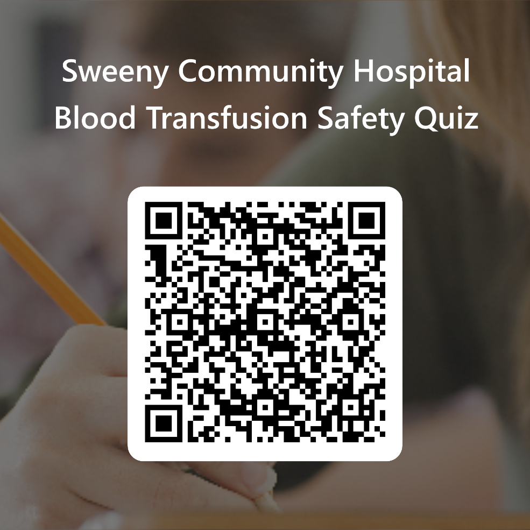
Following the link or scan the QR code for the Required Quiz.
https://forms.office.com/r/vmSHHL5cMh

